Slide 1
Java I/O in Java
By Vijay Kumbhar

Slide 2
Introduction:
Java programming language comes with a variety of APIs that helps the developers to code more efficiently. One of those APIs is Java IO API. Java IO API helps the users to read and write data. In simple words, we can say that the Java IO helps the users to take the input and produce output based on that input.

Slide 3
Java I/O (Input and Output) is used to process the input and produce the output. Java uses the concept of a stream to make I/O operations fast. The java.io package contains all the classes required for input and output operations. We can perform file handling in Java by Java I/O API.

Slide 4
The Java IO API is placed in the java.io package. This package comprises almost all classes that a user requires to perform input and output (I/O) in Java. The Java IO package focuses on input and output to files, network streams, etc. However, the Java IO package does not include classes to open network sockets which are essential for network communication.

Slide 5

The java.io package generally involves reading basic information from a source and writing it to a destination. The below figure perfectly demonstrates the principle of a program taking input data from a source and producing output based on it to some destination.

Slide 6
Java IO Streams
In the programming world, a stream can be described as a series of data. It is known as a stream because it is similar to a stream of water that continues to flow. Java IO streams are flows of data that a user can either read from or write to. Like an array, a stream has no concept of indexing the read or write data. A stream is attached to a data origin or a data target.

Slide 7
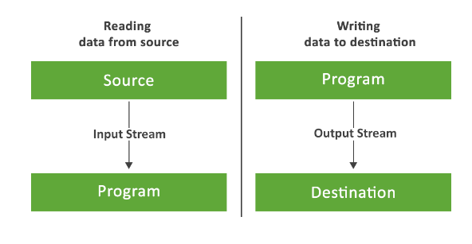

Slide 8
InputStream – An input stream is used to read the data from a source in a Java application. Data can be anything, a file, an array, a peripheral device, or a socket. In Java, the class java.io.InputStream is the base class for all Java IO input streams.

Slide 9
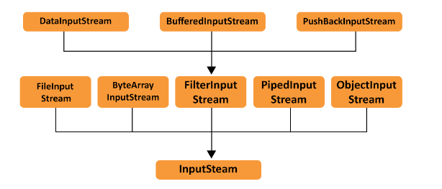

Slide 10
Methods
Methods of Java IO InputStreams
read() – The read() method is used to read the next byte of data from the Input Stream. The value byte is passed on a scale of 0 to 255. If no byte is free because the end of the stream has arrived, the value -1 is passed.
mark(int arg) – The mark(int arg) method is used to mark the current position of the input stream. It sets read to limit, i.e., the maximum number of bytes that can be read before the mark position becomes invalid.
reset() – The reset() method is invoked by mark() method. It changes the position of the input stream back to the marked position.
close() – The close() method is used to close the input stream and releases system resources associated with this stream to Garbage Collector.
read(byte [] arg) – The read(byte [] arg) method is used to read the number of bytes of arg.length from the input stream to the buffer array arg. The bytes read by read() method are returned as an int. If the length is zero, then no bytes are read, and 0 is returned unless there is an effort to read at least one byte.
skip(long arg) – The skip(long arg) method is used to skip and discard arg bytes in the input stream.
markSupported() – The markSupported() method tests if the inputStream supports the mark and reset methods. The markSupported method of Java IO InputStream yields false by default.

Slide 11
OutputStream
OutputStream – An output stream is used to write data (a file, an array, a peripheral device, or a socket) to a destination. In Java, the class java.io.OutputStream is the base class for all Java IO output streams.

Slide 12
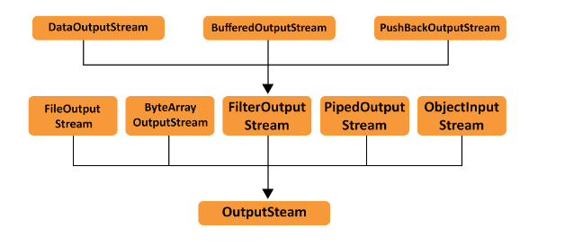

Slide 13
Methods
flush() – The flush() method is used for flushing the outputStream This method forces the buffered output bytes to be written out. close() – The close() method is used to close the outputStream and to release the system resources affiliated with the stream. write(int b) – The write(int b) method is used to write the specified byte to the outputStream. write(byte [] b) – The write(byte [] b) method is used to write bytes of length b.length from the specified byte array to the outputStream.

Slide 14
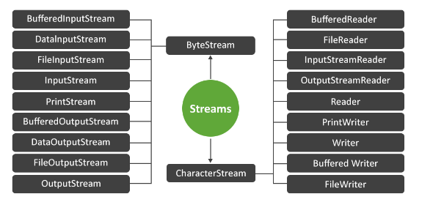
Types of Stream

Slide 15
1: Byte Streams
Byte Streams – Java byte streams are the ones that are used to implement the input and output of 8-bit bytes. Several classes are affiliated with byte streams in Java. However, the most generally practiced classes are FileInputStream and FileOutputStream.

Slide 16
Different classes of Byte Streams
S. No. | Stream Class | Description
1 | InputStream | This is an abstract class that defines stream input.
2 | FileInputStream | This is used to reads from a file.
3 | DataInputStream | It contains a method for reading java standard datatypes.
4 | BufferedInputStream | It is used for Buffered Input Stream.
5 | PrintStream | This class comprises the commonly used print() and println() methods.
6 | OutputStream | This is an abstract class that describes stream output.
7 | FileOutputStream | This class is used to write to a file.
8 | DataOutputStream | This contains a method for writing java standard data types.
9 | BufferedOutputStream | This is used for Buffered Output Stream.

Slide 17
2: Character Streams
Java Character streams are the ones that are used to implement the input and output for 16-bit Unicode.
Several classes are associated with character streams in Java, but the most commonly used classes are FileReader and FileWriter.
Internally, the FileReader class uses FileInputStream and the FileWriter class uses FileOutputStream.
The significant contrast is that FileReader and FileWriter read and write two bytes, respectively.

Slide 18
Different classes of Character Streams:
S. No. | Stream Classes | Description
1 | Reader | This is an abstract class that defines character stream input.
2 | Writer | This is an abstract class that defines character stream output.
3 | FileReader | This is an input stream that reads from the file.
4 | FileWriter | This is used to the output stream that writes to the file.
5 | BufferedReader | It is used to handle buffered input streams.
6 | BufferedWriter | This is used to handle buffered output streams.
7 | InputStreamReader | This input stream is used to translate the byte to the character.
8 | OutputStreamReader | This output stream is used to translate characters to bytes.
9 | PrintWriter | This contains the most used print() and println() methods.

